Slide 1
Data Science Club - Week 4
By Kevin and Vincent

Slide 2
Lesson 3
01
02
Case Study - Conversion Rate
Linear Regression

Slide 3
01
Conversion Rate

Slide 4
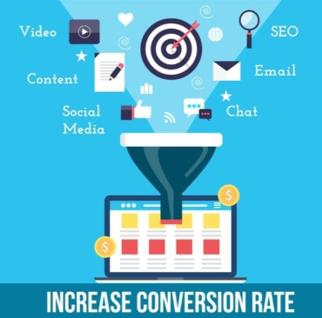
Optimizing Conversion Rate
There is a lot of data on users that visit different websites: companies find out whether they converted or not(such as buying a product) as well as some of their characteristics such as their country, the marketing channel, their age, whether they are repeat users and the number of pages visited during that session
Optimizing conversion rates is used to:
Analyze historical data to identify patterns;
Recommend changes for the product team and the marketing team to improve conversion rate.

Slide 5
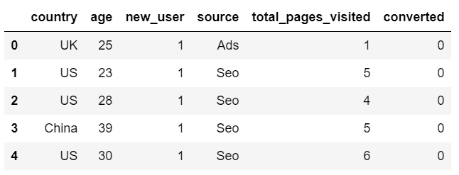
Conversion Rate Dataset

Slide 6
02
Linear Regression

Slide 7
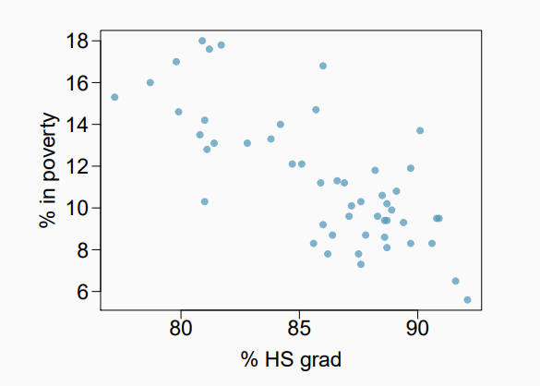
Poverty vs High School Graduation Rate
The scatterplot shows the relationship between HS graduate rate the US and the percentage of residents who live in poverty.
Response variable (dependent): % in poverty
Explanatory variable (independent):
% HS grad
Relationship:
Linear

Slide 8
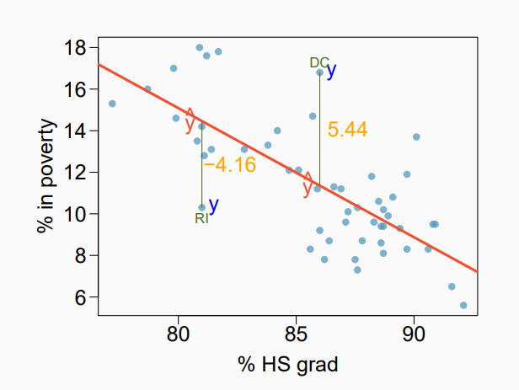
Simple Linear Regression Model
Error between the fitted line and the original Y:
e = Y’ - Y
Y’ = 17 + b1 * x
intercept
slope

Slide 9
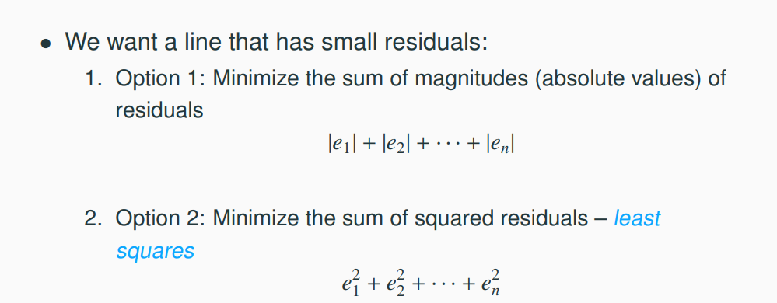
Finding Best Fitting Line

Slide 10
Least Square Regression
Why do we choose to minimize the least squares?
Commonly used
Easy to compute, both by computer or by closed form formula

Slide 11
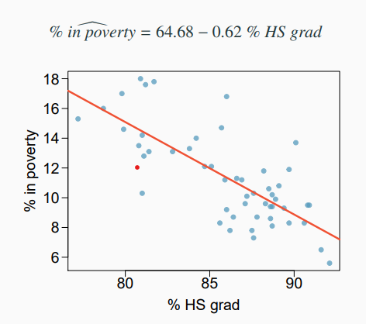
Least Square Regression
By minimizing the least squared errors, we obtain:

